Slide 1
Identify Diversity Dimensions
The Inclusive Team

Slide 2
Concept - Connectors and Triangulation
Company Website Connector
Scrape company websites to mine leadership information
Recursively access internal links to mine diversity information
Mine for “Awards” for companies to look for certifications.
Predict gender and ethnicity using Out of the box NLP models.
Adapt to a common model “CompanyProfile”
CAGE Report Connector
Leverage DUNS Number and scrape in CAGE website.
Adapt gathered information to a common model “CompanyProfile”
DNB Website Connector
Search for DNB Url for a given company name
Leverage Selenium driver to hit DNB url to work around “Access Denied” errors
Predict gender and ethnicity using Out of the box NLP models.
Mine information and adapt to a common model “CompanyProfile”
Triangulate results
Vote from the 3 available results

Slide 3
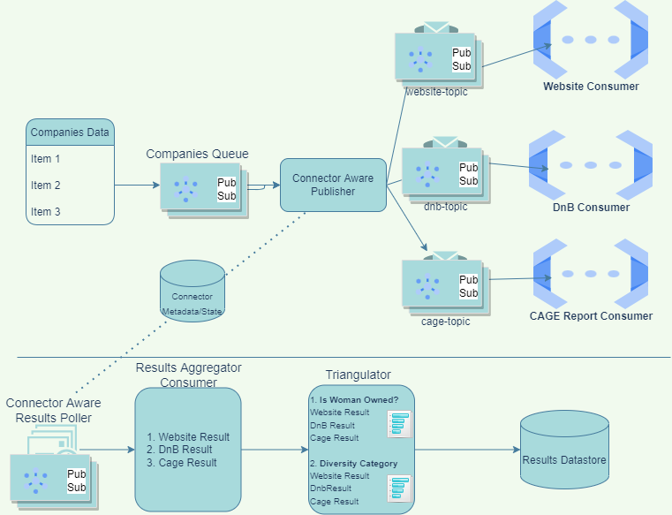
System Design

Slide 4
Tech Stack / Libraries Leveraged
Python
Spacy / NER for Named Entity Recognition and NLP Models training
Sklearn Logistic Regression models for predicting out of the box models
Selenium WebDriver
Google Cloud Platform Services
Compute Engine for VM instances
Custom Google Search and Site Restricted Search for programmatic google search (We would have run into the dreaded 429 Too many requests otherwise)
Google Pubsub constructs for scalable architecture
Cloud Functions (Proof of concept) for anonymous function invocations.
Redis
For state maintenance and results aggregator mechanism
Other Collaboration Software
Slack for Collab
GitHub for source code repository

Slide 5
Challenges and how we looked to tackle
Google Search returning 420 Too many requests | Leveraged Custom Google Search (Although this came with a cost)
DNB website blocked programmatic requests | Programmatically choose from random user agents. Selenium WebDriver seemed to mitigate some blocking. Did it work? 1 in 3 requests were still failing with “Access Denied”
Out of the box NLP models - Gender classification poor accuracy | We attempted to build a corpus with ground truth labels, but this was not a trivial task.
Ethnicity classification of detected named entities using out of the box NLP models performed poorly. | This was expected as name based ethnicity detection is not a trivial task in itself. We attempted to gather news and perform “Context-based” ethnicity detection - Although we could not adapt to the full dataset.
LGBTQ+ classification | Unable to solve this as there are no known methods to classify based on names only.

Slide 6
Given enough time and resources, we would like to..
Train NLP models with balanced dataset to better classify ethnicity based on input text content.
Build a Wells Fargo internal (carefully) Crowdsourced Labelling tool ala Amazon Mechanical Turk to label/ground truth classifications. This will help mitigate bias in AI.
Develop News Connectors for scraping/mining sentiments and news on Companies. (Again, by being cognizant of the bias introduced by newswires)

